Slide 1
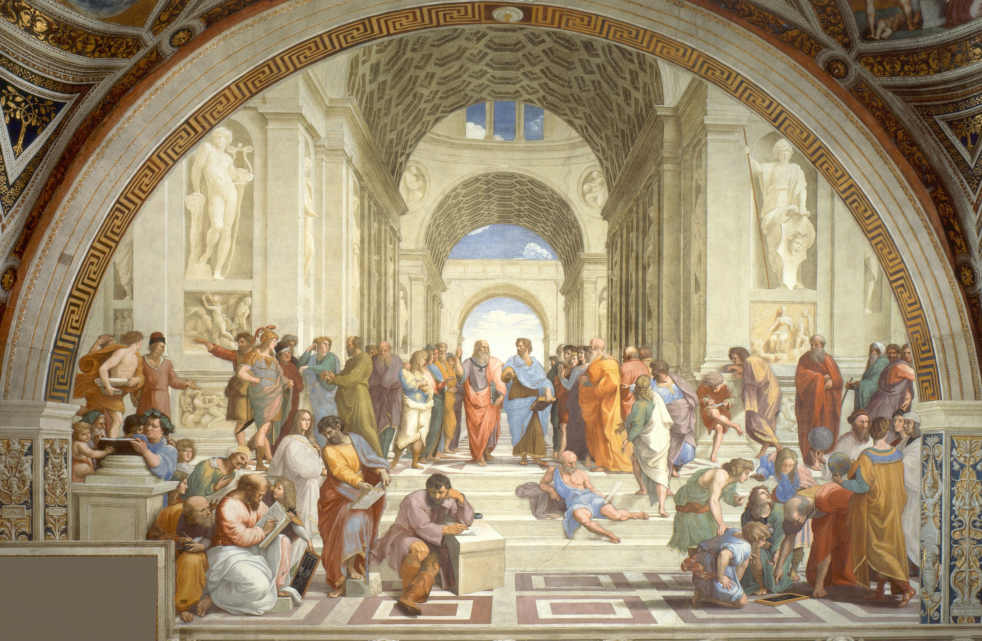
HSS 175: Introduction to Psychology
Evolution and neuroscience
Prof. John Wilcox

Slide 2
Outline
“Nature” vs. “nurture” debate
Evolutionary “nature” explanations:
Biological concepts
Evolutionary theory
Neuroscientific “nature” explanations:
Neuroscientific concepts
Methods to determine biological bases of psychology
Neural correlates of psychology

Slide 3
What explains mental and behavioral phenomena?
Examples:
Aggression
Depression
Sexual behavior
Two (seemingly) competing explanations:
Nature: Our genes or other predetermined features of our biology explain these phenomena
Example: Tim is aggressive because of his genetic or hormonal makeup
Nurture: Our environment or other non-biological features explain these phenomena:
Example: Tim is aggressive because he learned from aggressive parents or listens to aggressive music

Slide 4
What explains mental and behavioral phenomena?
Exercise:
Pair up
Discuss this question:
Pick some psychological phenomenon, like examples mentioned earlier
Discuss whether it is better explained in terms of nature or alternatively nurture
Come back to class discussion and share your answers

Slide 5
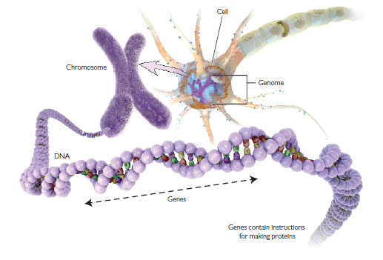
What is our nature? Biological concepts
Cells:
Tiny units which collectively (along with bacteria) make up the body
Genome:
Full sequence of genes found on the chromosomes
Chromosome:
Typically, 46 strands of DNA, one pair of which are typically either XY (male) or XX (chromosomes)
DNA (deoxyribonucleic acid):
Helix-like structure containing genes
Genes:
Contain instructions for producing proteins

Slide 6
Genotypes vs. phenotypes
Genotype: An organism’s set of genes transmitted from their parents
Example: Genes that permit an individual to be tall if they have adequate nutrition
Example: The MAOA gene disposes an individual to violent and other kinds of antisocial behavior if they are maltreated
Phenotype: An organism’s set of observable traits
Example: Their actual height, determined by their genes and their nutrition (among other things)
Example: An individual’s actual antisocial behavior

Slide 7
Heritability
The heritability of a trait is the extent to which the trait is influenced by genetic versus environmental factors
Often measured from 0 to 1:
$0≈$ trait is attributable to largely environmental factors
$1≈$ trait is attributable to largely genetic factors
How to test heritability?
Adoption and twin studies: If a trait has high heritability, then the probability that two monozygotic twins (i.e. from the same egg) adopted in different environments should have the same trait should be relatively high (perhaps higher than the base rate)
Evolutionary explanations: If a trait has a plausible evolutionary explanation, then this raises the prior probability that it is heritable

Slide 8
Where does the genotype come from?
An answer from an evolutionary perspective
(while acknowledging the existence of other perspectives)

Slide 9
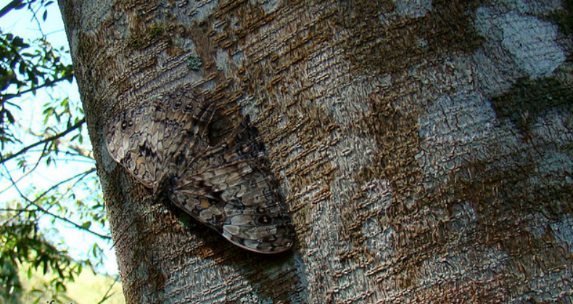
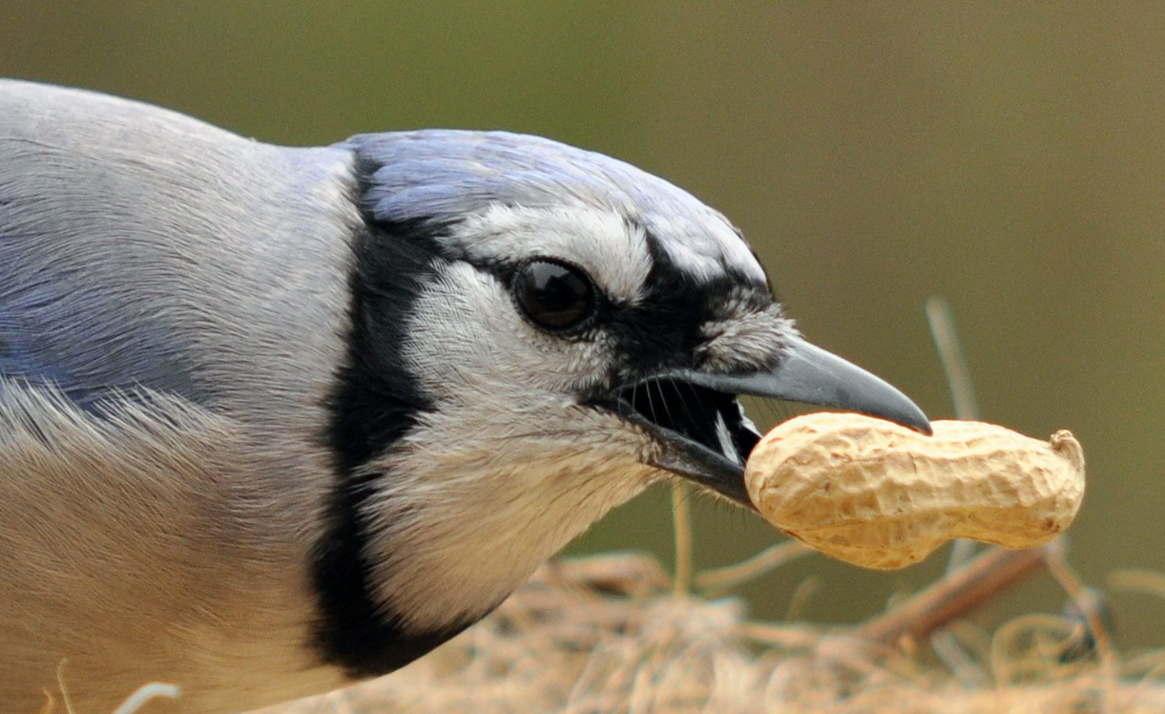
Evolution by natural selection (NS)
Common descent: All species descend from one (or a few) ancestors
Variation: Over time, variations will occur in the descendants
We now know this happens (at least partly) through random mutations introduced via the fusion of parent’s genotypes during reproduction
Natural selection: Variations which are more conducive to survival and reproduction will be more likely to be passed down to descendants, the “survival of the fittest”
Example: Butterflies with better camouflages are more likely to survive where birds are preying on butterflies
Example: Birds with thicker beaks for tougher seeds are more likely to survive where smaller seeds are depleted
Implications: All species evolved from some common ancestor(s) by natural selection acting on random mutations
Misconception: According to NS, evolution is not a designer: it is not biased towards producing good adaptations, but merelytowards selecting those good adaptations that are produced randomly

Slide 10
Examples of putative explanations of psychological phenomena in terms of natural selection
Bipedalism (walking on two legs)
Enabled us to “explore new environments and exploit new resources”?
Intelligence
Making more accurate judgments and better decisions?
Language
“Simple instructions for making tools, finding a good hunting or fishing spot, and avoiding danger would save time, effort, and lives”?

Slide 11
Evolutionary explanations of mental and behavioral phenomena
Exercise:
Pair up
Discuss this question:
Pick some psychological phenomenon, like examples mentioned earlier
Discuss how it could have arisen from evolution by natural selection
Come back to class discussion and share your answers

